Slide 1
Welcome to
McLean Crew Club
2022-2023 Season
Student Interest Night

Slide 2
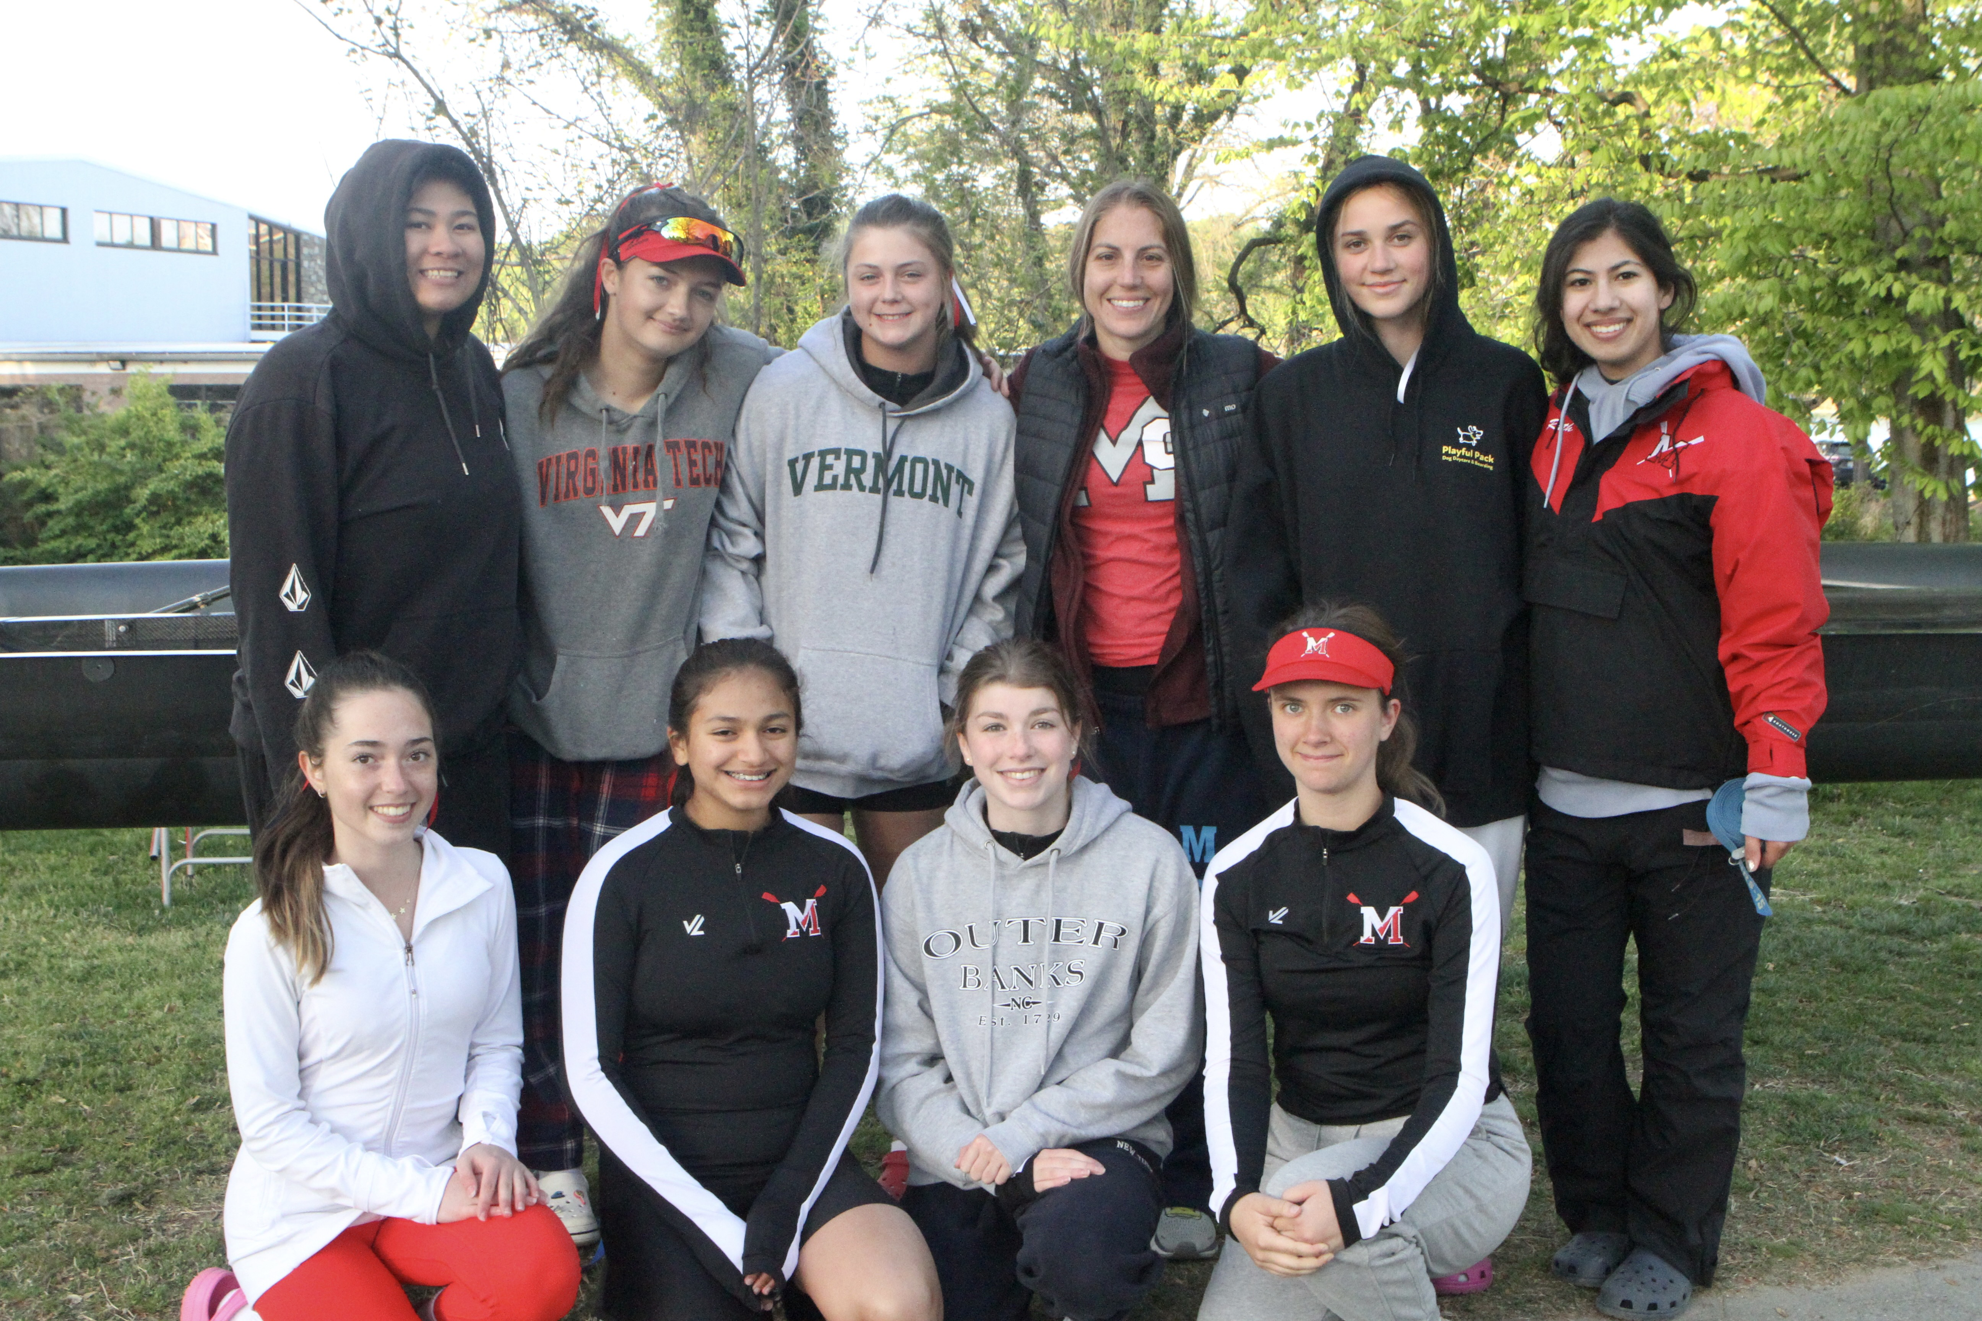

Slide 4
Three things you should know about the McLean Crew Club

Slide 5
You don’t have to know what you’re doing – yet.
You can excel at rowing even if you’ve never rowed before. Most kids haven’t ever rowed.
We’ll teach you and train you.

Slide 7
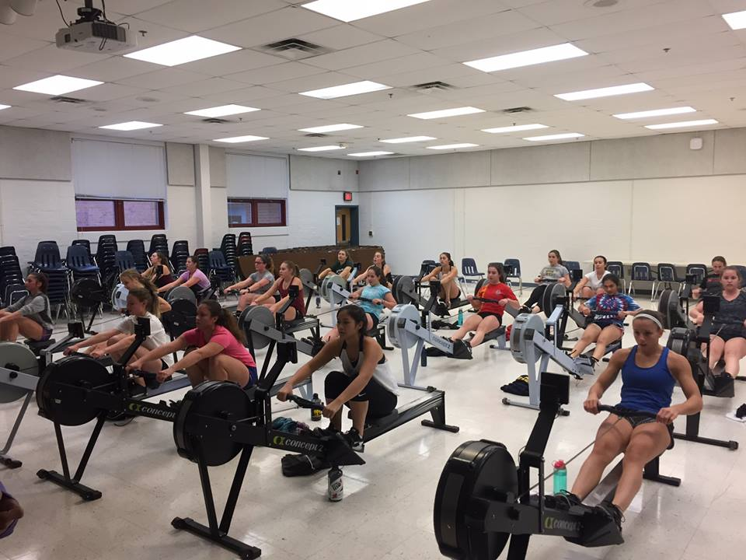
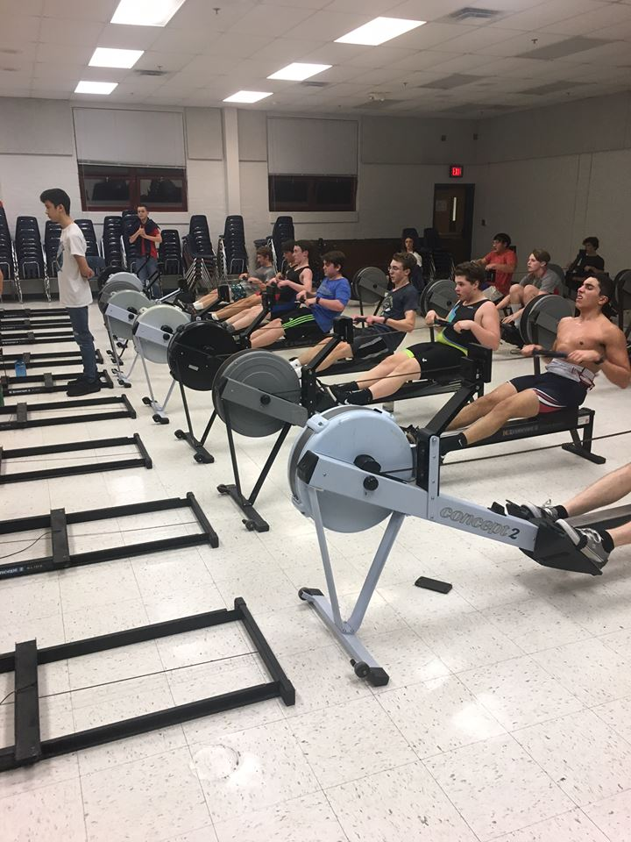

Slide 9
You’re going to get really fit
We start training in November and continue with regular practices through early June. You’ll be amazed at what you can accomplish with 8 months of working out.

Slide 13
You’ll find your tribe
Rowers spend a lot of time together and share lots of hard work, dedication and a whole new vocabulary. You’ll become a member of the rowing tribe quickly.

Slide 14
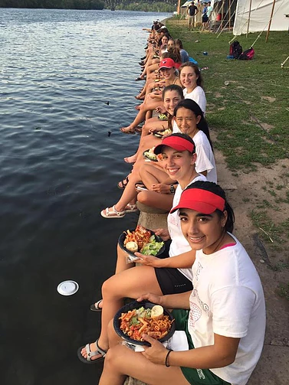

Slide 24
What does it take?

Slide 25
Training
Learn-to-Row: Novices only – not mandatory
Winter conditioning: November – February, one day off during week
Mandatory Spring Break Training: April 3-7

Slide 26
Racing
Regatta Season: March – May
Daily practices + Saturdays
Home between 7 and 7:30 PM
5-6 weekend regattas
Stotesbury & Nationals IF QUALIFY

Slide 27
Volunteering & dues
Parent volunteers are the only way we work. $400,000 non-profit, w/ no financial or administrative support from the school
Dues equivalent to a travel team

Slide 28
Important dates
Tomorrow night – Parent Interest Meeting – 6:00PM
15 or 18 September: Swim Test for Learn-to-Row
19/21 September and 27/29 September: Learn-to-Row Sessions
March weekend TBD: Mulch Madness
Spring Break: April 3-7

