Slide 1
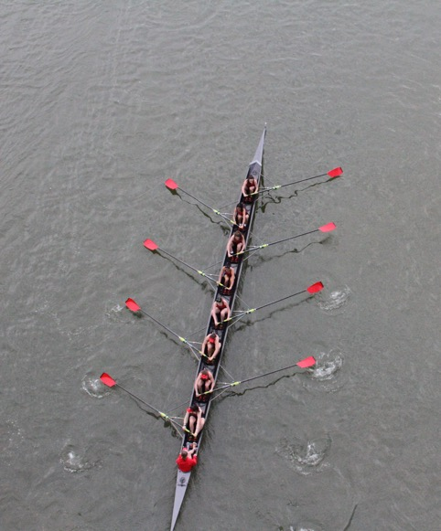
Regatta 101 spring 2023

Slide 2
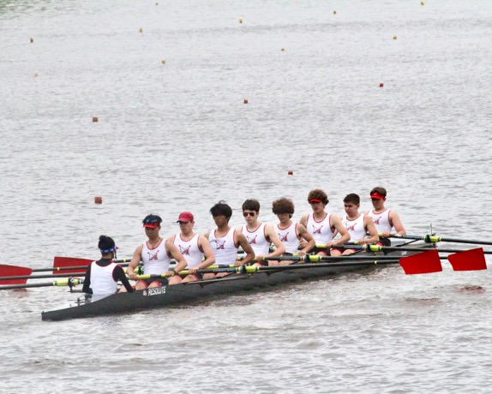
AGENDA
The Boats
The Boat
The Heat Sheet
The Spectators
The Regatta Schedule
The Regattas
Q&A

Slide 3
The boats
First Varsity 8 (1V) – Fastest varsity boat
Second Varsity 8 (2V) – Second fastest varsity boat
Junior Varsity 8 (JV8) – No seniors may row in this boat (not often raced at MHS)
----------------------------------------------------------------------------------------------------------------------------
Third Varsity 8 (3V) – Third fastest varsity boat
Fourth Varsity 8 (4V) – Fourth fastest varsity boat (not often raced at MHS)
----------------------------------------------------------------------------------------------------------------------------
Freshman 8 (F8) – Meant to be the fastest freshman boat
Novice 8 (N8) – Next fastest boat and can also include non-freshman novices
Indicates a boat raced by MCC in a typical season

Slide 4
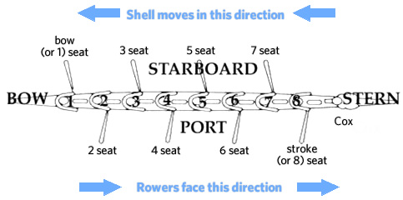
The boat

Slide 5
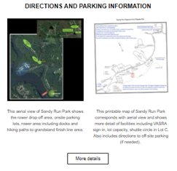
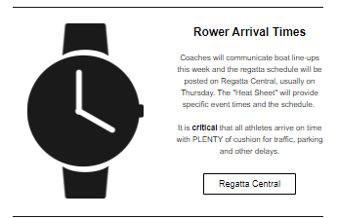
The heat sheet
Racing categories
Heats, flights, and finals
Not great cell reception at the Occoquan grandstands, so download, screenshot, or print out the heat sheet!
Communications from MCC – Samples→

Slide 6
The spectators
Outdoor sport…and all the glory and the misery that entails
Wear hiking shoes or tennis shoes for Sandy Run / Occoquan – lots of walking
Dress in layers – often cold in the AM and hot in the PM
Most seats are in the sun, so sunscreen is useful
Binoculars will make the event much more interesting!
Concrete grandstands or bring a folding chair to sit closer to the water. A stadium seat can make the grandstands more comfy too.
There is a concession stand selling food and drinks directly behind the grandstands
There are bathrooms behind the grandstands, but no running water
Cow bells and drums will be out in force
Most spectators wear school colors and sit together
Rowing is the ultimate team sport, so it is considered rude to cheer for an individual. Instead, all cheering is directed at the full boat
As rowers row out to the starting line, they often get a loud greeting or cheer from their fans, but it is rude to do this if other boats are on the course racing at that time.

Slide 7
3/18 Polar Bear @ Occoquan 3/25 REGIONAL PARK REGATTA @ Occoquan 4/1 Lake Lenape @ Lake Lenape NJ (boys) / Scrimmage @ TBC (girls) 4/3-4/7 Spring break 4/8 St Andrew’s @ Middletown DE 4/15 Ted Phoenix @ Occoquan 4/16 Manny Flick @ Philadelphia PA 4/22 Scrimmage @ TBC 4/29 Charlie Butt @ TBC 5/6 States Day 1 @ Occoquan (lower boats) 5/13 States Day 2 @ Occoquan (upper boats) 5/19-20 Stotesbury @ Philadelphia PA (select crews) 5/26-27 SRAA @ Oak Ridge TN (qualified crews)
REGATTA SCHEDULE
Notes:
Select crews for Stotes means coaches pick those boats they believe will perform well
Qualified crews for Nats means the boat has qualified for SRAAs based upon their performance VSRC

Slide 8
The Regattas @ Occoquan
Sandy Run / VASRA “Local” Occoquan Regattas:
3/18 Polar Bear
3/25 Regional Park Regatta
4/15 Ted Phoenix
5/6 States Day 1
5/13 States Day 2
You’ll drop your rower at Sandy Run and park at designated location (each approximately 10 minutes away). From there, you’ll take the shuttle bus to the venue. At the venue, there’s a hike through the woods to reach the Grandstand. The next slide details which parking lot to use for regattas.
Please note the following:
Allow 1.5 hours ahead of race time to deal with it all
Some regattas have block scheduling, noted on next slide
Off site shuttles will begin running at 7:30 am and, as usual, continue for approximately 1 hour after the regatta. The cost is $15 per person.
Once on site there is a 0.6 mile trail through the woods to the viewing grandstands

Slide 9
Sandy run / Occoquan parking
Event Start Times* | Regatta | Event Format | Athletes | Parking Location
 |  |  | Scheduled
9:00 A.M. | Polar Bear Regatta | Not Block Schedule | 802 | South County HS 8501 Silverbrook Rd, Lorton, VA 22079
9:00 A.M. | Regional Park Regatta | 8+ First Events | 1408 | Commuter Parking Lot 1325 Old Bridge Rd Woodbridge VA 22192
9:00 A.M. | Ted Phoenix Regatta | 8+ First Events | 1599 | Commuter Parking Lot 1325 Old Bridge Rd Woodbridge VA 22192
8:00 A.M. | VSRC Championships (“States,” lower boats) | Not Block Schedule | 1094 | South County HS 8501 Silverbrook Rd, Lorton, VA 22079
8:00 A.M. | VSRC Championships (“States,” upper boats) | Not Block Schedule | 1156 | South County HS 8501 Silverbrook Rd, Lorton, VA 22079
* The coaches will inform rowers and coxswains what time they need to arrive for each event.

Slide 10
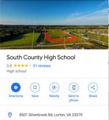
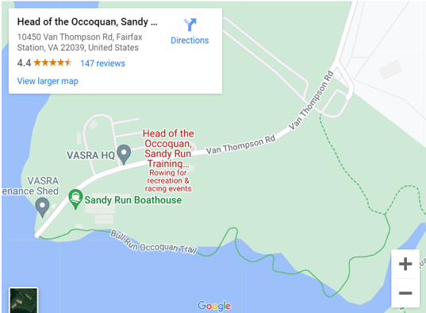
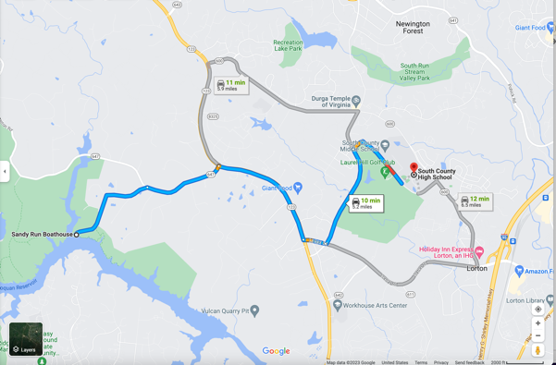
Sandy Run Drop-Off & South County Parking
Only coaches and special volunteers can park close-by. You’ll drop off your athlete and need to exit to park at the high school.
You’ll park in the designated parking area and look for the shuttles
DROP-OFF POINT
When the South County parking lot is available you will park there (located at 8501 Silverbrook Rd, Lorton, VA 22079)

Slide 11
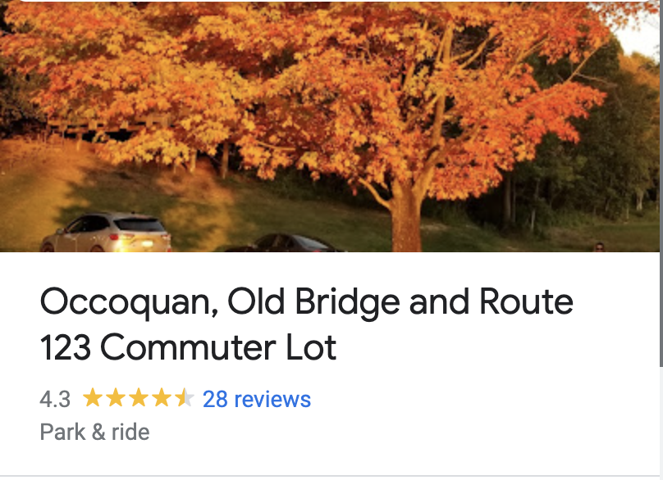
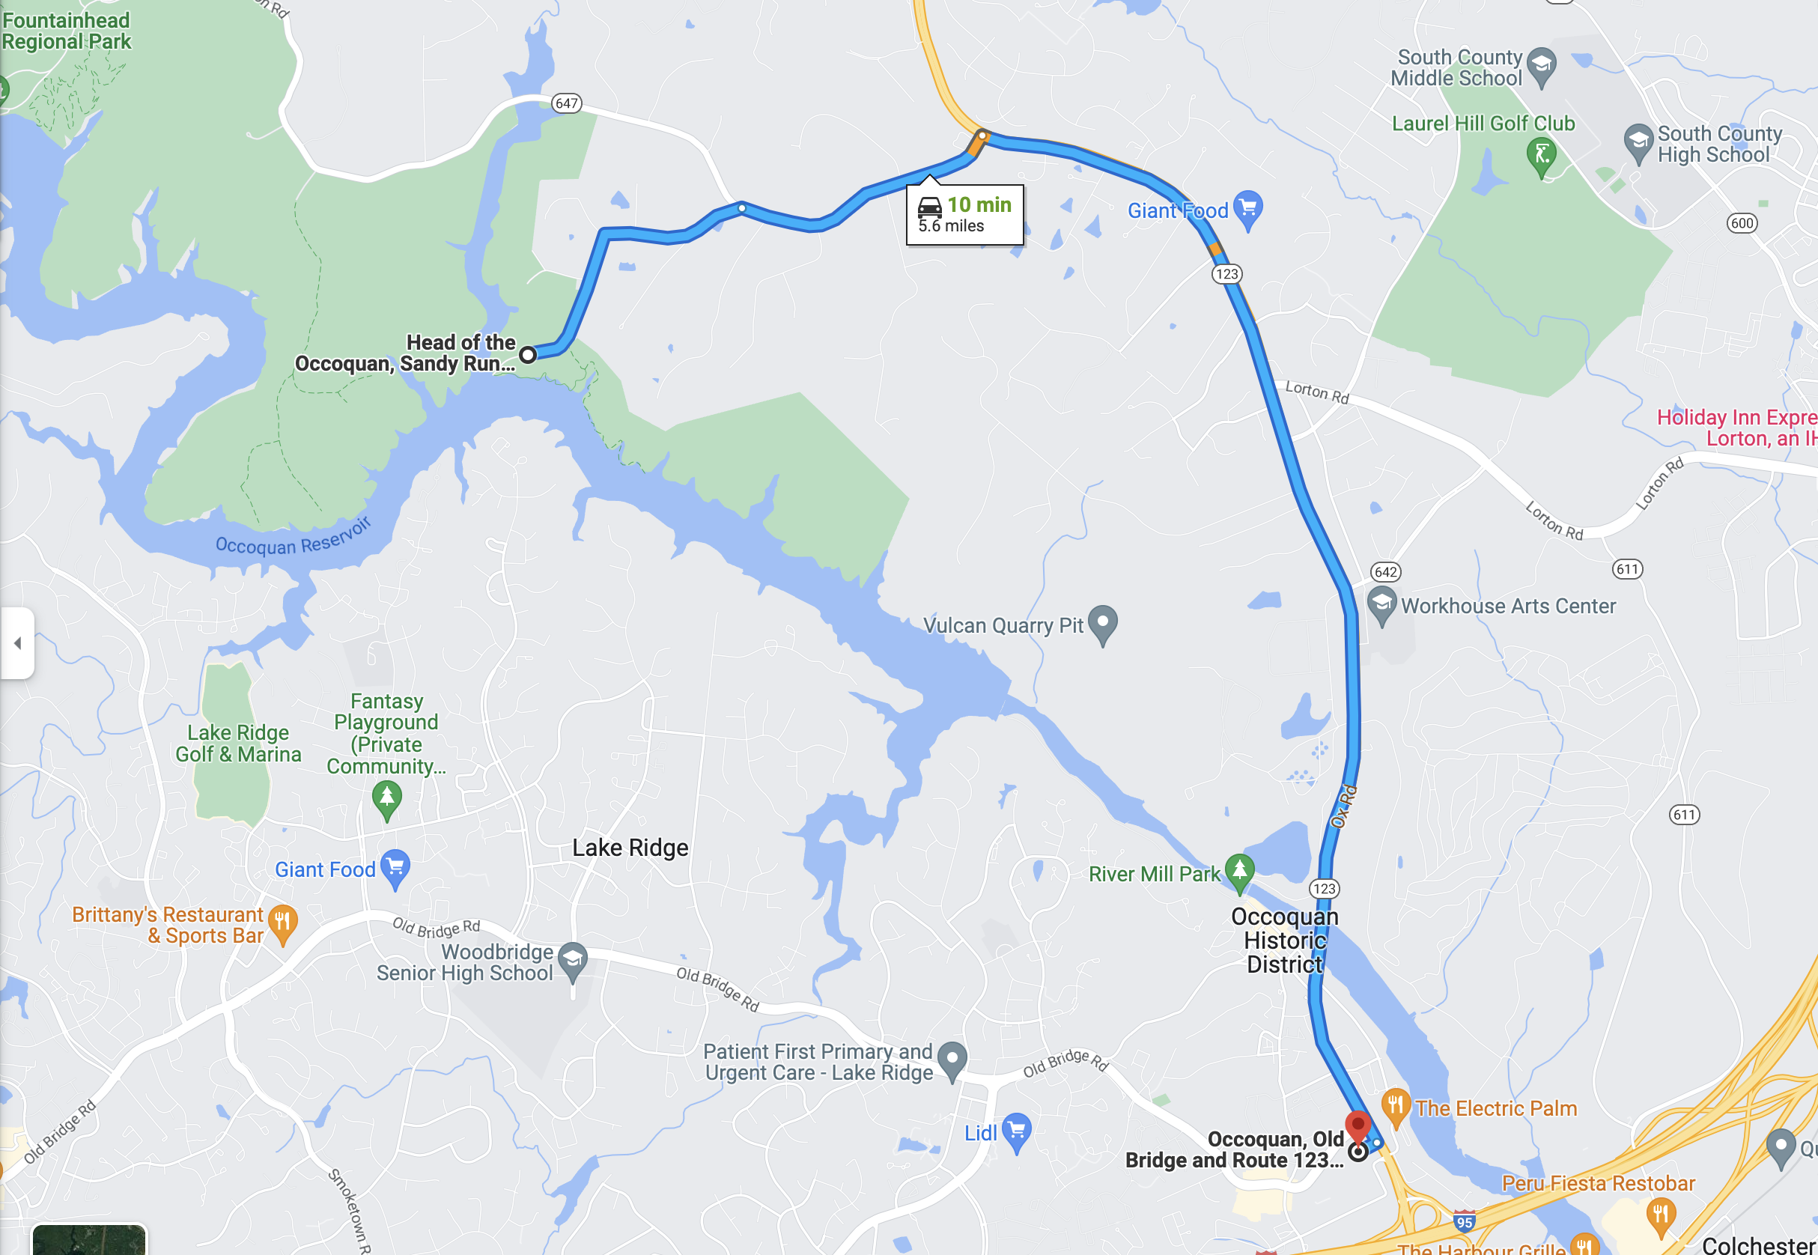
Sandy Run Drop-Off & Commuter Lot Parking
Only coaches and special volunteers can park close-by. You’ll drop off your athlete and need to exit to park at the high school.
You’ll park in the designated parking area and look for the shuttles
DROP-OFF POINT
When the Commuter Lot is designated, the location is: 1325 Old Bridge Rd Woodbridge VA 22192

Slide 12
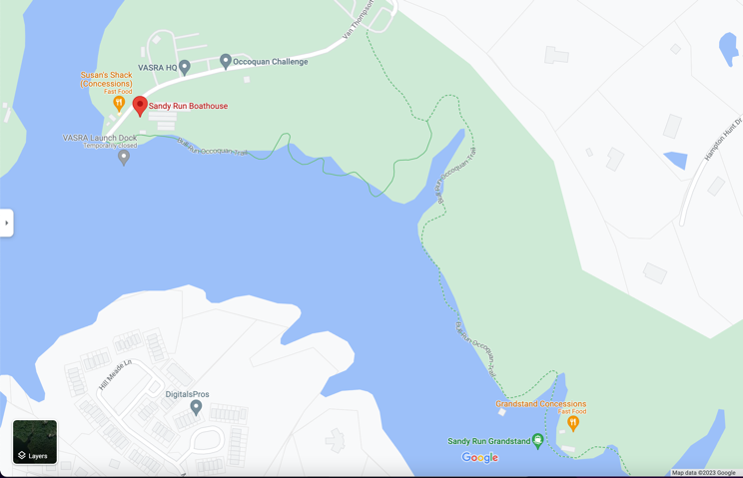
sandy run / occoquan: the trail to the grandstand
SHUTTLE DROP-OFF
THE GREEN LINE SHOWS THE WALKING PATH TO THE GRANDSTAND
THE GRANDSTAND
Once on site there is a 0.6 mile trail through the woods to the viewing grandstands. Vans from parking Lot C to the Finish Line will begin operations at 8:00 am and continue until 30 minutes after the conclusion of racing. The cost is $5 per person.

Slide 13
The Regattas @ TBC and Out of State
Thompson Boat Center (TBC) / Georgetown Regattas:
4/1 Scrimmage @ TBC (girls)
4/22 Scrimmage @ TBC
4/29 Charlie Butt @ TBC - Best grandparent regatta, right in front of Georgetown waterfront, restaurants, etc.
Away Regattas during the Regular Season:
4/1 Lake Lenape @ Lake Lenape, NJ (boys)
4/8 St Andrew’s @ Middletown, DE - Dead Poets Society filmed there
4/16 Manny Flick @ Philadelphia, PA

Slide 14
The Regattas: Post Season
Select or Qualified Boats Only
Stotesbury Cup, Philadelphia, PA
5/19-20 Stotesbury @ Philadelphia PA (select crews)
Held since 1927 on the Schuylkill River near the famous “Boathouse Row”
Largest high school regatta in the world, 5,000 rowers, 10,000 spectators
2 day, 3 night trip
Time Trials Friday, Races Saturday
Leave Thursday midday, return Saturday evening (Absences and test make-up dates arranged with the school)
SRAA Nationals, Oak Ridge, TN
5/26-27 SRAAs @ Oak Ridge TN (qualified crews)
1V must qualify for any other boats that qualify to participate
2 day, 3 night trip
Heats Friday, Finals Saturday
Leave Thursday midday, return Saturday evening (Absences and test make-up dates arranged with the school)

Slide 15
QUESTIONS & ANSWERS
THANK YOU FOR ATTENDING AND SUPPORTING MCC!
Regattachair@mcleancrew.org – Regatta Chair inquiries

