Slide 1
Welcome to
McLean Crew Club
2022–2023 Season
Parent Interest Meeting

Slide 2
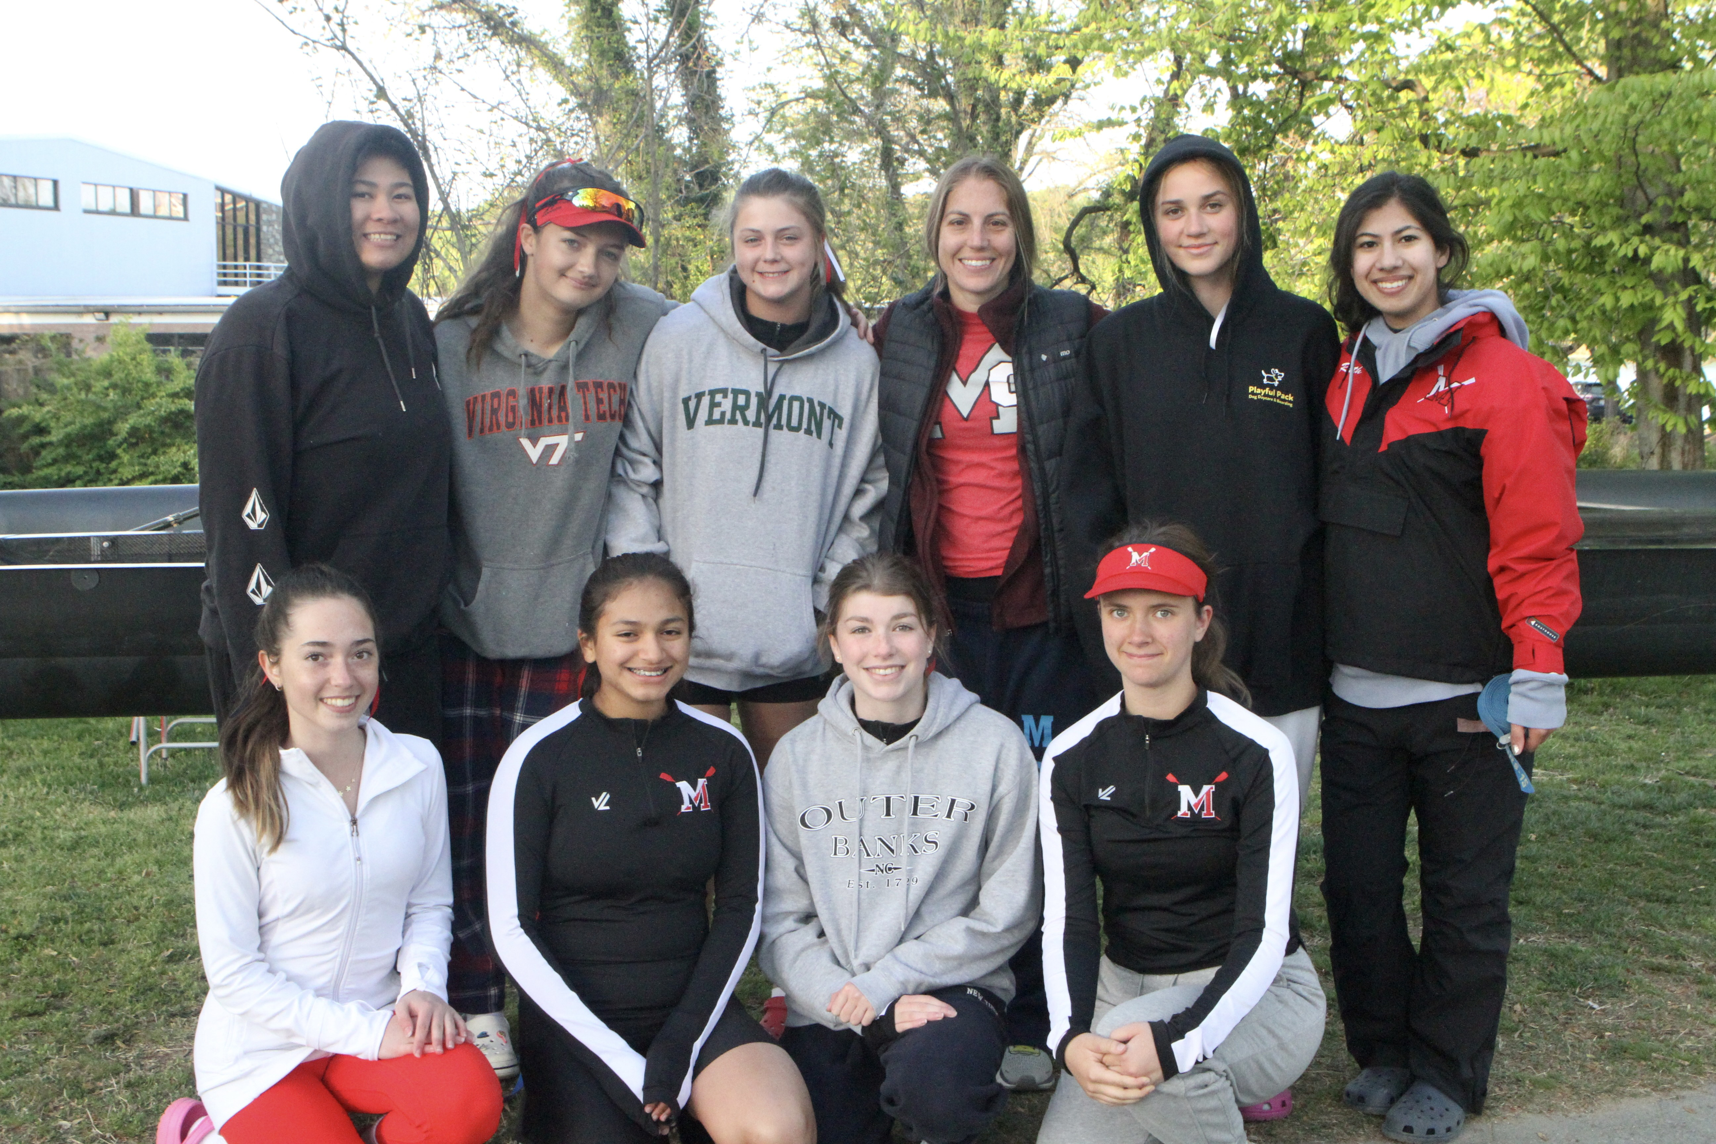

Slide 4
Seven things McLean Crew Club could do for your child

Slide 5
1. Give them grit, resilience and incredible leg muscles

Slide 11
2. Make them into the ultimate team player

Slide 17
3. Increase their discipline and focus

Slide 19
4. Transform their attitude and commitment to healthy eating

Slide 20
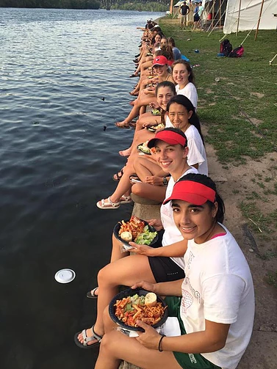

Slide 21
5. Unlock their
hidden champion

Slide 24
6. Expand and strengthen their college options

Slide 26
7. Help them
find their tribe

Slide 33
What does it take?

Slide 34
Learn-to-Row: Novices only – not mandatory
Session 1 – 19 and 21 September
Session 2 – 27 and 29 September
Swim Test required on 15 or 18 September
Winter conditioning: November – mid-February, 1 day off/week
Mandatory local Spring Break training: April 3 - 7

Slide 35
Racing
Regatta Season: March – May
Daily practices + Saturdays
Weekdays: home between 7 and 7:30 PM
5-6 weekend regattas
Stotesbury & Nationals IF QUALIFY

Slide 36
Volunteering & dues
Parent volunteers are the only way we work. $400,000 non-profit, w/ no financial or administrative support from the school
Dues equivalent to a travel team

Slide 37
Cost
2021-2022: most novice rowers paid:
About $2,500 for dues, spring break training and uniforms,
And contributed another $750 to the club per person through fundraising.
Plus, rowers in championship boats paid:
An additional $900 to travel to and compete in two national competitions
So approximately $3,400 in fees + fundraising for championship boats for spring 2022 season.

Slide 38
How many spots are there?
Boys and Girls teams 50 rowers maximum each

Slide 39
Important dates
September:
Learn-to-Row Registration opens 9pm 14 Sep
Swim Test 15 or 18 Sep
Learn-to-Row Sessions 19/21 Sep or 27/29 Sep
October 13: First Membership meeting
November: Winter conditioning begins
March weekend TBD: Mulch Madness
April 3-7: Spring Break

