Slide 1
What you always wanted to know about crew….but no one thought to tell you!
Or…
There are CRABS in the Potomac River?
Notes:
It’s not always easy being a novice crew parent! Let’s see if we can make it a smidgen easier.

Slide 2
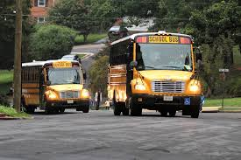
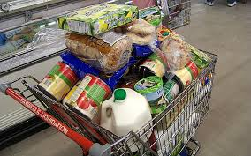
The essentials . . .
Your child will learn to manage their time
- During the winter conditioning season practices will be 2 hours a day during the week and roughly 1 hour every Saturday morning. Specific times vary season to season.
- During the spring season, rowers board buses headed for Thompson Boat House (TBC) on the Georgetown waterfront to begin practice at 3:00. Rowers are usually back at the school between 6:30 - 7:00 PM.
Your grocery bill is about to
increase even more.

Slide 3
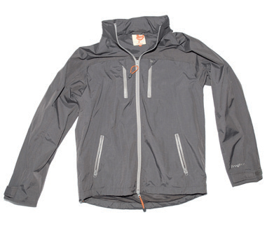
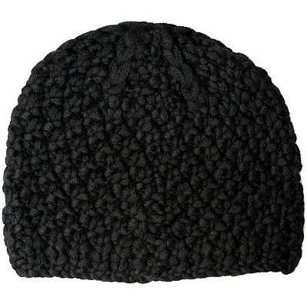
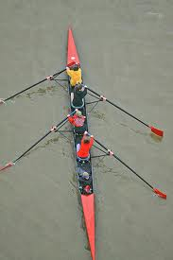
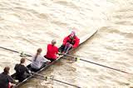
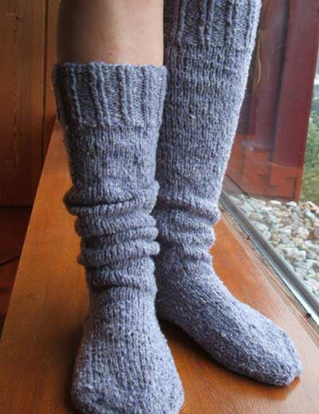
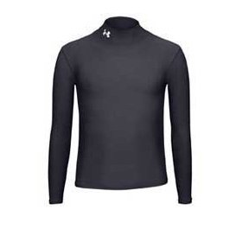
It might be a Spring sport, but it’s not Spring yet!
Exhibit A Exhibit B
Notes:
It’s COLD on that river! Early in the spring season rowers should dress in layers. No cotton! Instead, they wear synthetic fabrics that dry quickly. And don’t let them forget warm socks and a knit cap. It’s also usually a good idea to bring some dry clothes for the ride home on the bus (there’s a lot of splashing out there on the river).

Slide 4
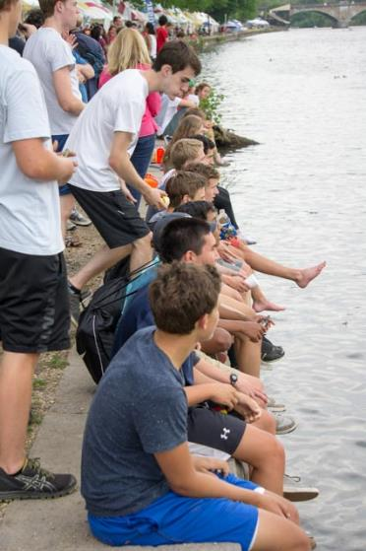
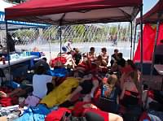
Label everything!
Notes:
With as many rowers as we have and the amount of chaos involved, at least one piece of your child’s clothing WILL accidentally go home with someone else. Labeling everything will help to minimize this as much as possible.

Slide 5
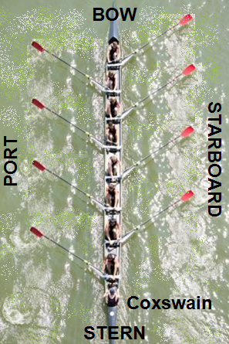
A world turned upside down!
Rower’s sit backwards, so the front of the boat (the bow) is behind them
The back of the boat (stern) is in front of the rower
Port (left) = right side of rower
Starboard (right)= left side of rower
All from the coxswain’s perspective
Notes:
You might not know much about rowing, but you know that port is left and starboard is right. Right? Nope, not to your rower. In their world, port is right and starboard is left. Why? Because everything is from the coxswain’s perspective, and the cox sits facing the rowers - so everything in the cox’s world is the opposite for the rowers. (And in case you’re wondering… the coxswain is the oar-less person who’s steering the boat!)

Slide 6
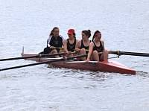
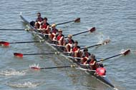
What’s with all the numbers?
4
8
Coxswain, 4 (stroke), 3, 2, 1 (bow)
Coxswain, 8 (stroke), 7, 6… 1 (bow)
Notes:
First, boats are referred to by the number of rowers. A boat with 4 rowers is called a “four.” A boat with 8 rowers is referred to as an “eight.” Well that’s easy! Now…the seating positions in the boats are ALSO referred to by numbers. The person the FURTHEST from the coxswain is #1 (also known as “bow” or the bow seat). The numbers then increase until they get to the coxswain. So, in a four, the person directly facing the cox is “4.” In an eight, that person is “8.” This rower directly opposite the coxswain is also referred to as the “stroke.” (And just so we’re clear, the person behind the stroke is 7, behind her is 6, etc).

Slide 7
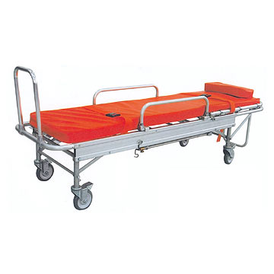
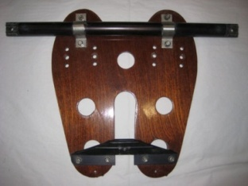
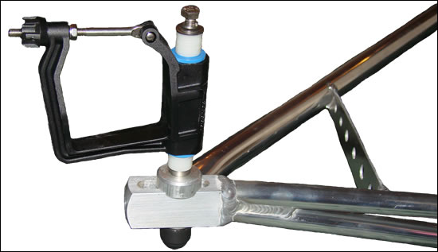
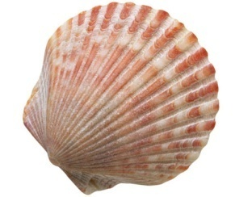
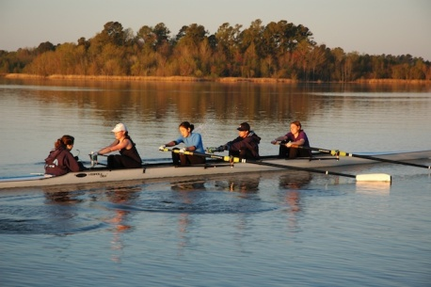
It is a whole new world…
X
A stretcher?!
The boat is rigged?!
X
It’s a shell?
Notes:
Get ready for lots of new vocabulary that has other meanings in the “non-rowing” world (don’t worry, you’ll soon forget that there even is such a world). The stretcher is the part of the boat on which the rowers put their feet (there are actually sneakers built into the stretchers – rowers leave their own shoes on the dock). The rigger consists of the metal struts that extend from the boat and support the oar (by the way, oars are also called “blades”). And shell is another (and more common) word for a crew boat.

Slide 8
Crabs in the Potomac River?
Notes:
When your rower comes home and tells you he or she “caught a crab,” they’re not referring to the crustacean. In rowing, one “catches a crab” when the blade on his or her oar gets caught in the water as the boat is moving quickly. This forces the oar into the body of the rower and often right out of the rower’s hands. It’s a tricky situation, but one that each rower will experience and learn how to recover from.

Slide 9
Rowing Terminology
The Stroke
Catch: The beginning of the stroke where the oar is inserted into the water.
Drive: The propelling part of the stroke.
Finish: Where the oar is taken out of the water.
Recovery: The slide forward before the catch.
Feathering: Turning the oar blade horizontally.
Squaring: Turning the oar blade vertically.
Rowing Commands
Arms only: Term used by coxswain instructing rowers to use only arms in rowing.
Back down: (or Back) Row backwards.
Check it: Same as "Hold or Hold Water".
Hold or Hold Water: Square the oar in the water (to stop the boat fast).
Paddle: Row easy, no power on the stroke.
Half Power: Next step up from "paddle." Next step is 3/4 power then Full power.
Power: Take strokes at full power.
Ready all-row: The command to start rowing. Should be preceded by From the Finish or From the Catch.
Way enough: Finish the stroke in progress and stop rowing.

Slide 10
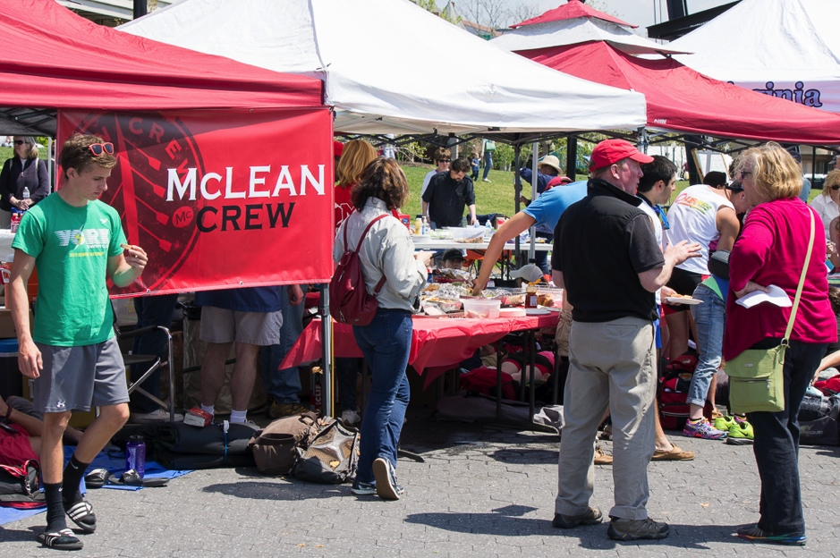
The regattas are a blast,
and experienced parents are always willing to show you the ropes.
So don’t be shy about volunteering for those too!
Notes:
Ensuring that regattas are successful events for our rowers requires many hands. And that means many parent volunteers. There are lots of jobs requiring various skills… you’re sure to find one that’s right for you. And…no worries…experienced parents are more than willing to show you the ropes. Besides all this…regattas are lots of fun!

Slide 11
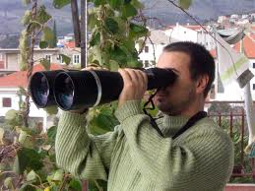
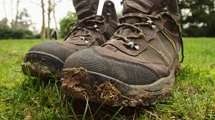
You might want to consider . . .
Binoculars
Zoom lenses
Hiking Boots depending on the venue
Chairs
Food?

Slide 12
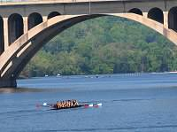
On the Potomac
TBC Tussle, Charlie Butt Regatta
Easy access, easy parking, tents along the Potomac, lots of great viewing points
Great for the grandparents who want to see a regatta
Notes:
In 2012 there are several regattas on the Potomac. Boats launch from Thompson Boat Center and the starting line is upriver above Key Bridge. There’s easy access to lots of great viewing points along the river.

Slide 13
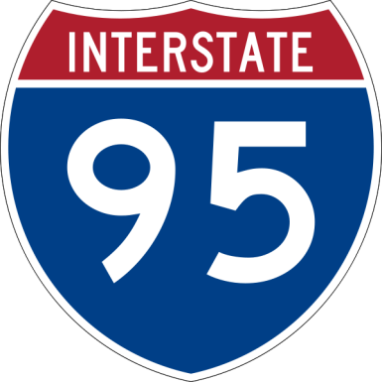
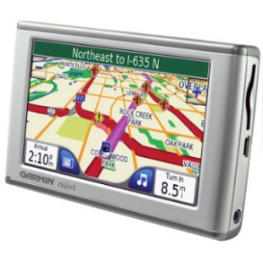
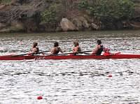
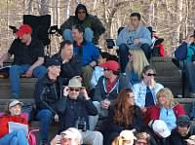
Occoquan
Bring your sturdy shoes, GPS, and emergency rations…
No… not for the trip down I-95… for the hike from the parking lot to the grandstands!
Notes:
The Occoquan is a gorgeous venue for rowing regattas. But it’s a little more complicated than a trek to the Potomac River. Getting into the Sandy Run Regional Park parking lot can be slow going, so allow extra time. Once you park your car, plan to stay (so stop at Starbucks beforehand -- there’s one in the shopping center just before you turn off Route 123). Then, be prepared for a hike to either the grandstands (great view of the finish line) or the boat launch area. There are concessions at both areas. And of course the MHS crew tent is always set-up at the trailer area with lots of good eats and good company too.

Slide 14
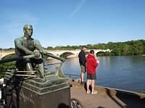
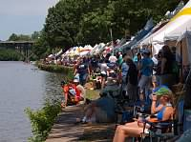
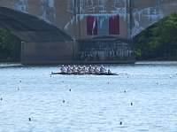
Stotesbury
Most fun you can have in Philadelphia!
5,600 rowers: 15,000 fans
A two-day festival of rowing!
Notes:
The Stotesbury regatta in Philadelphia is the largest high school rowing regatta in the world. It’s quite an experience, with teams from all over the country. Hundreds of tents are set-up along the Schuylkill river. We rent one close to the finish line and set-up our own MHS crew tent as well, so there’s lots of room for viewing, eating, chatting, and chillin’.

Slide 15
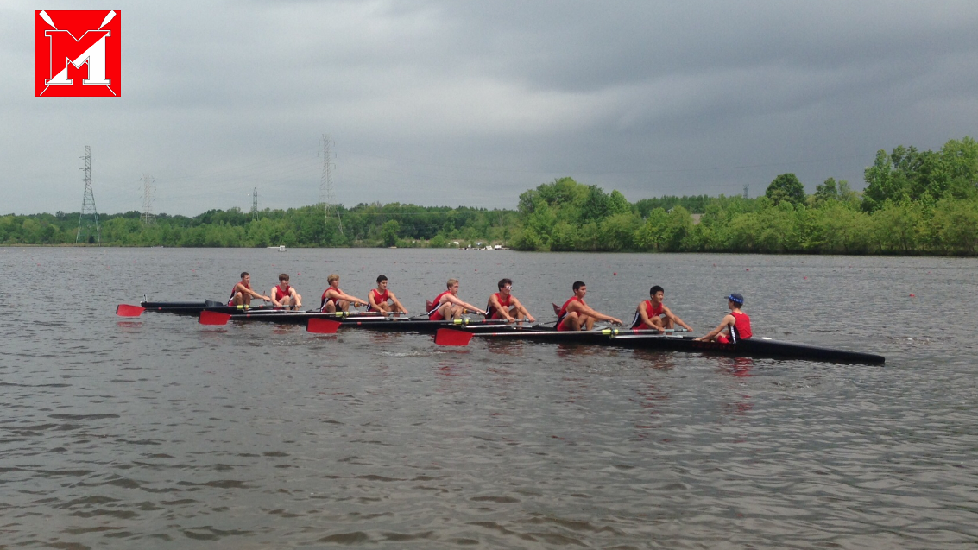
The most important thing to know…
www.mcleancrew.org
McLean High School Crew Club
Notes:
If you’re reading this, you already know about the many resources on the team web site!

